Slide 1

Work From Home During COVID-19
IST736 TEXT MINING
GROUP TWO
Antonio Luina
Bhavya K Madhavan
Daphne Chang
Tamilselvan Tamilmani
February 2021
Notes:
Bhavya

Slide 2
Agenda
Introduction
How People feel about working from home?
What people are doing during work from home?
Data Sources
Notes:
Bhavya

Slide 3
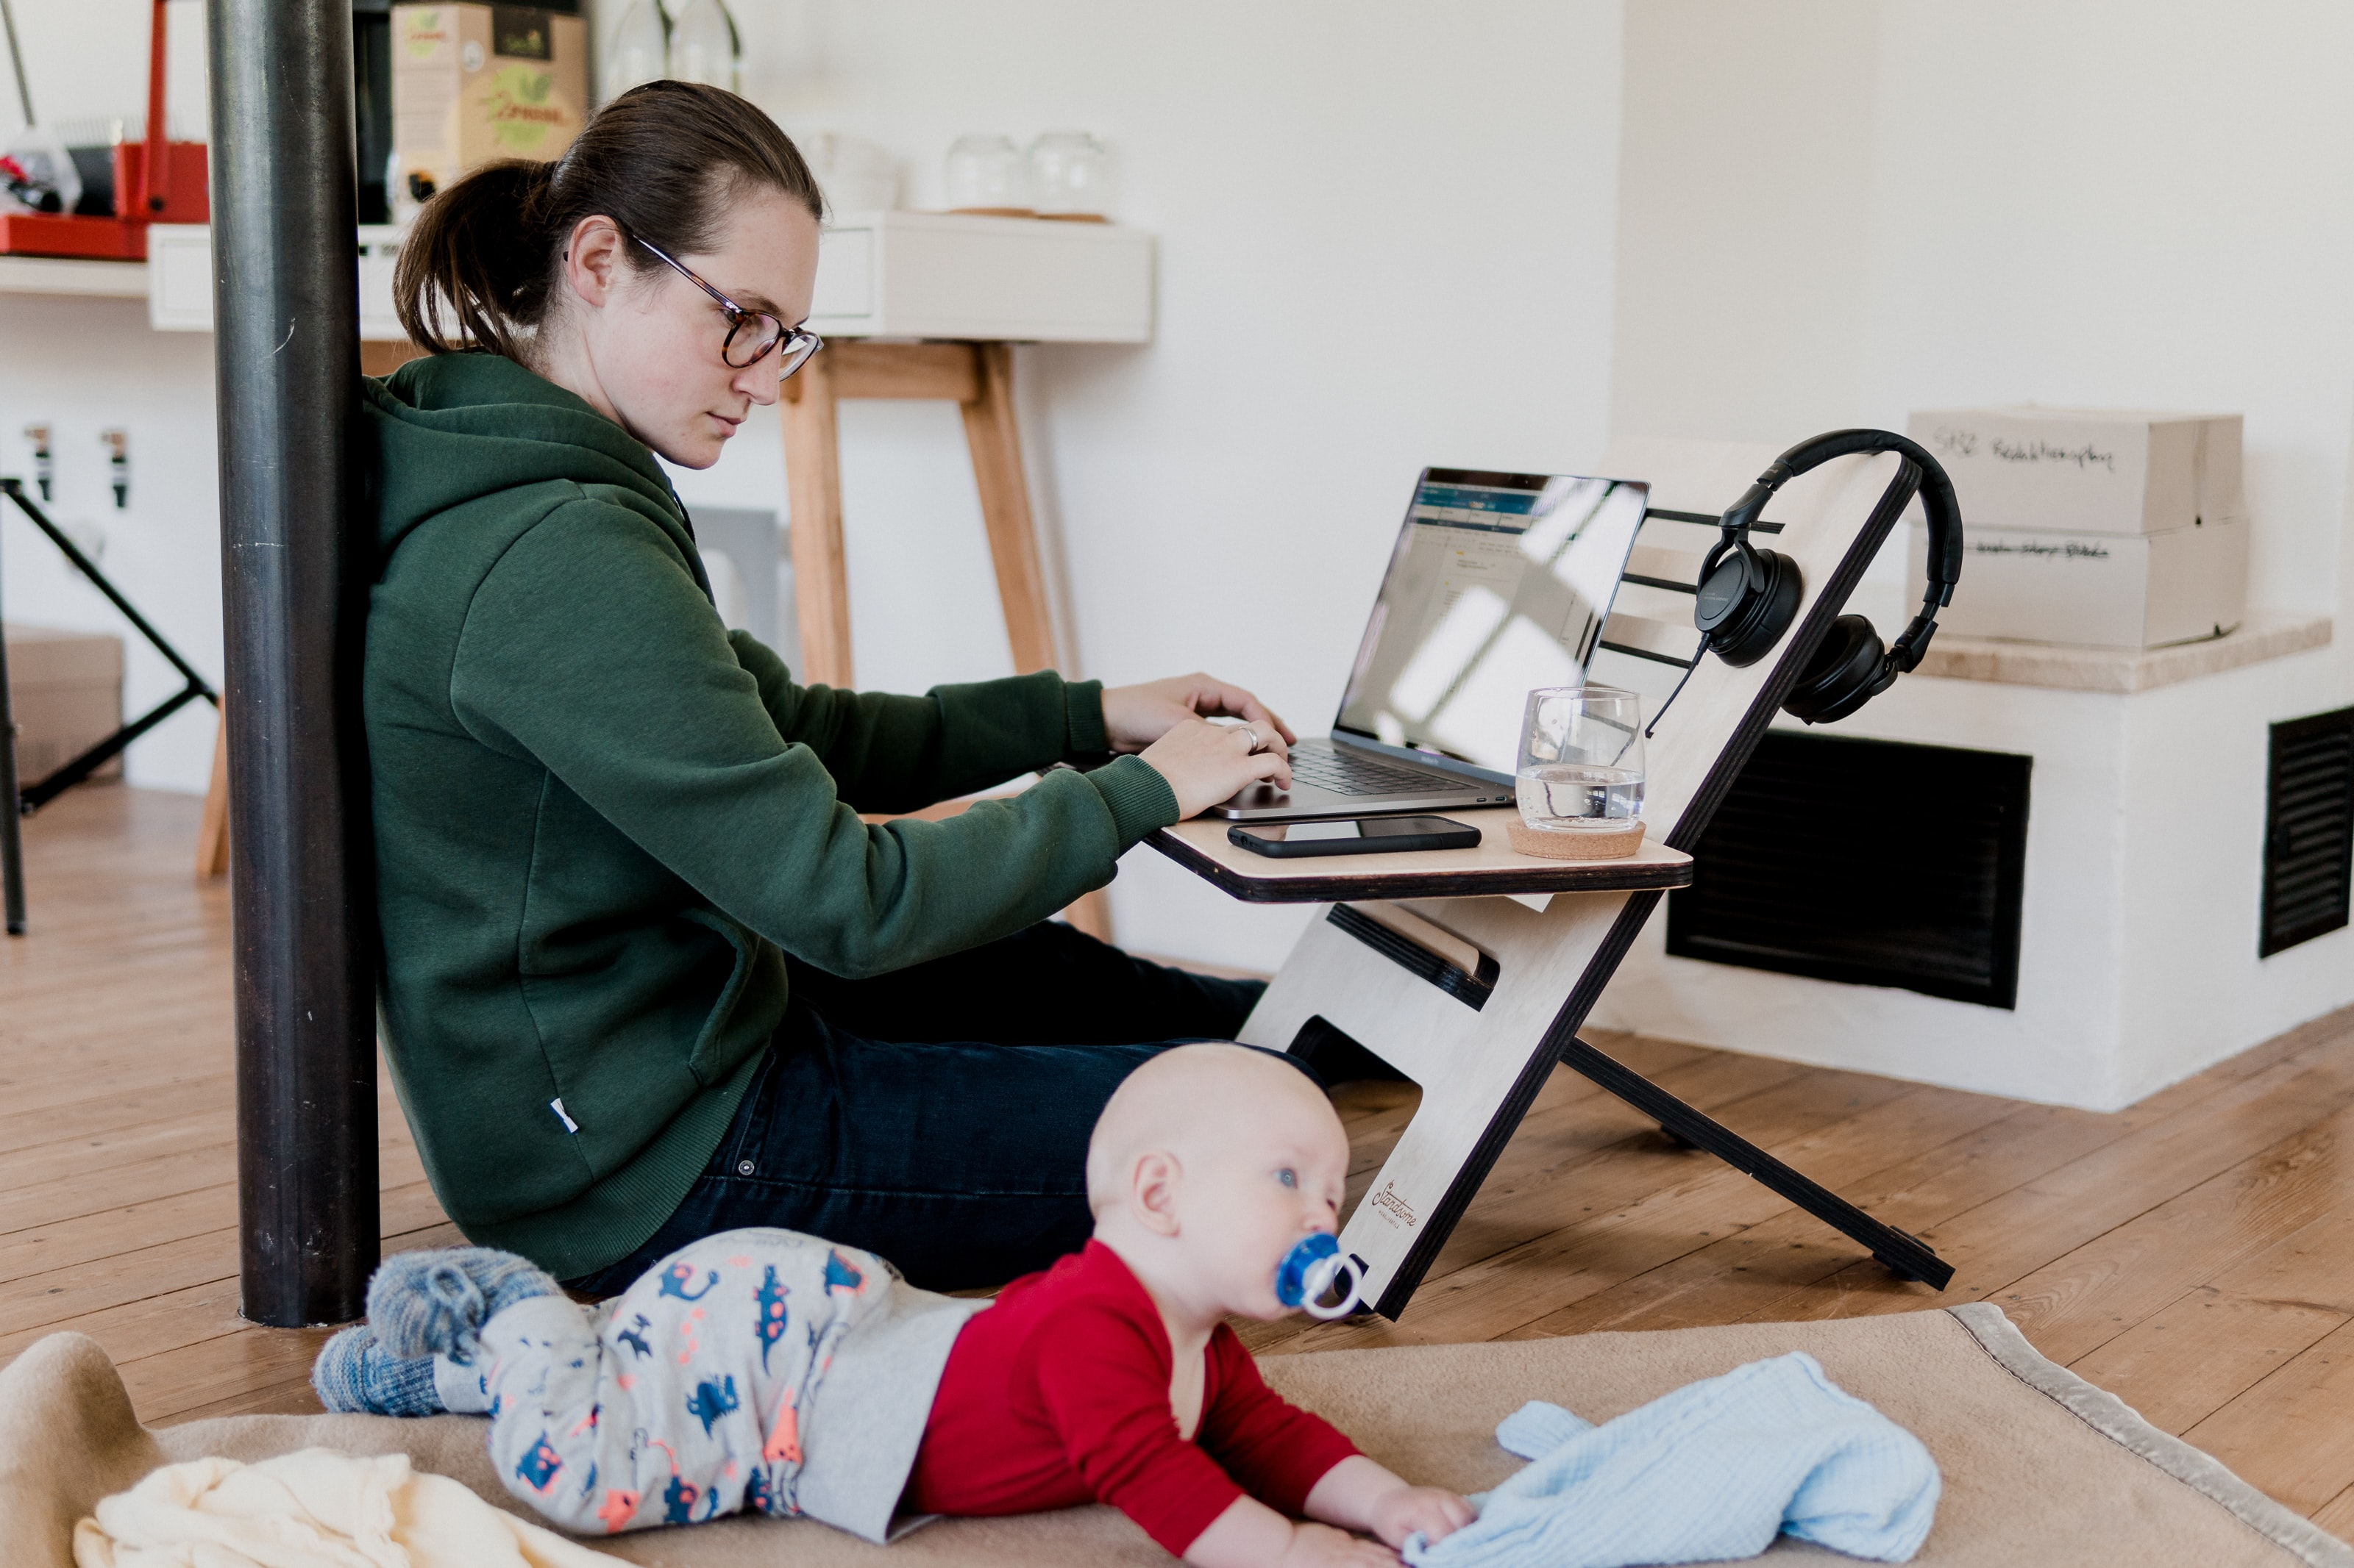
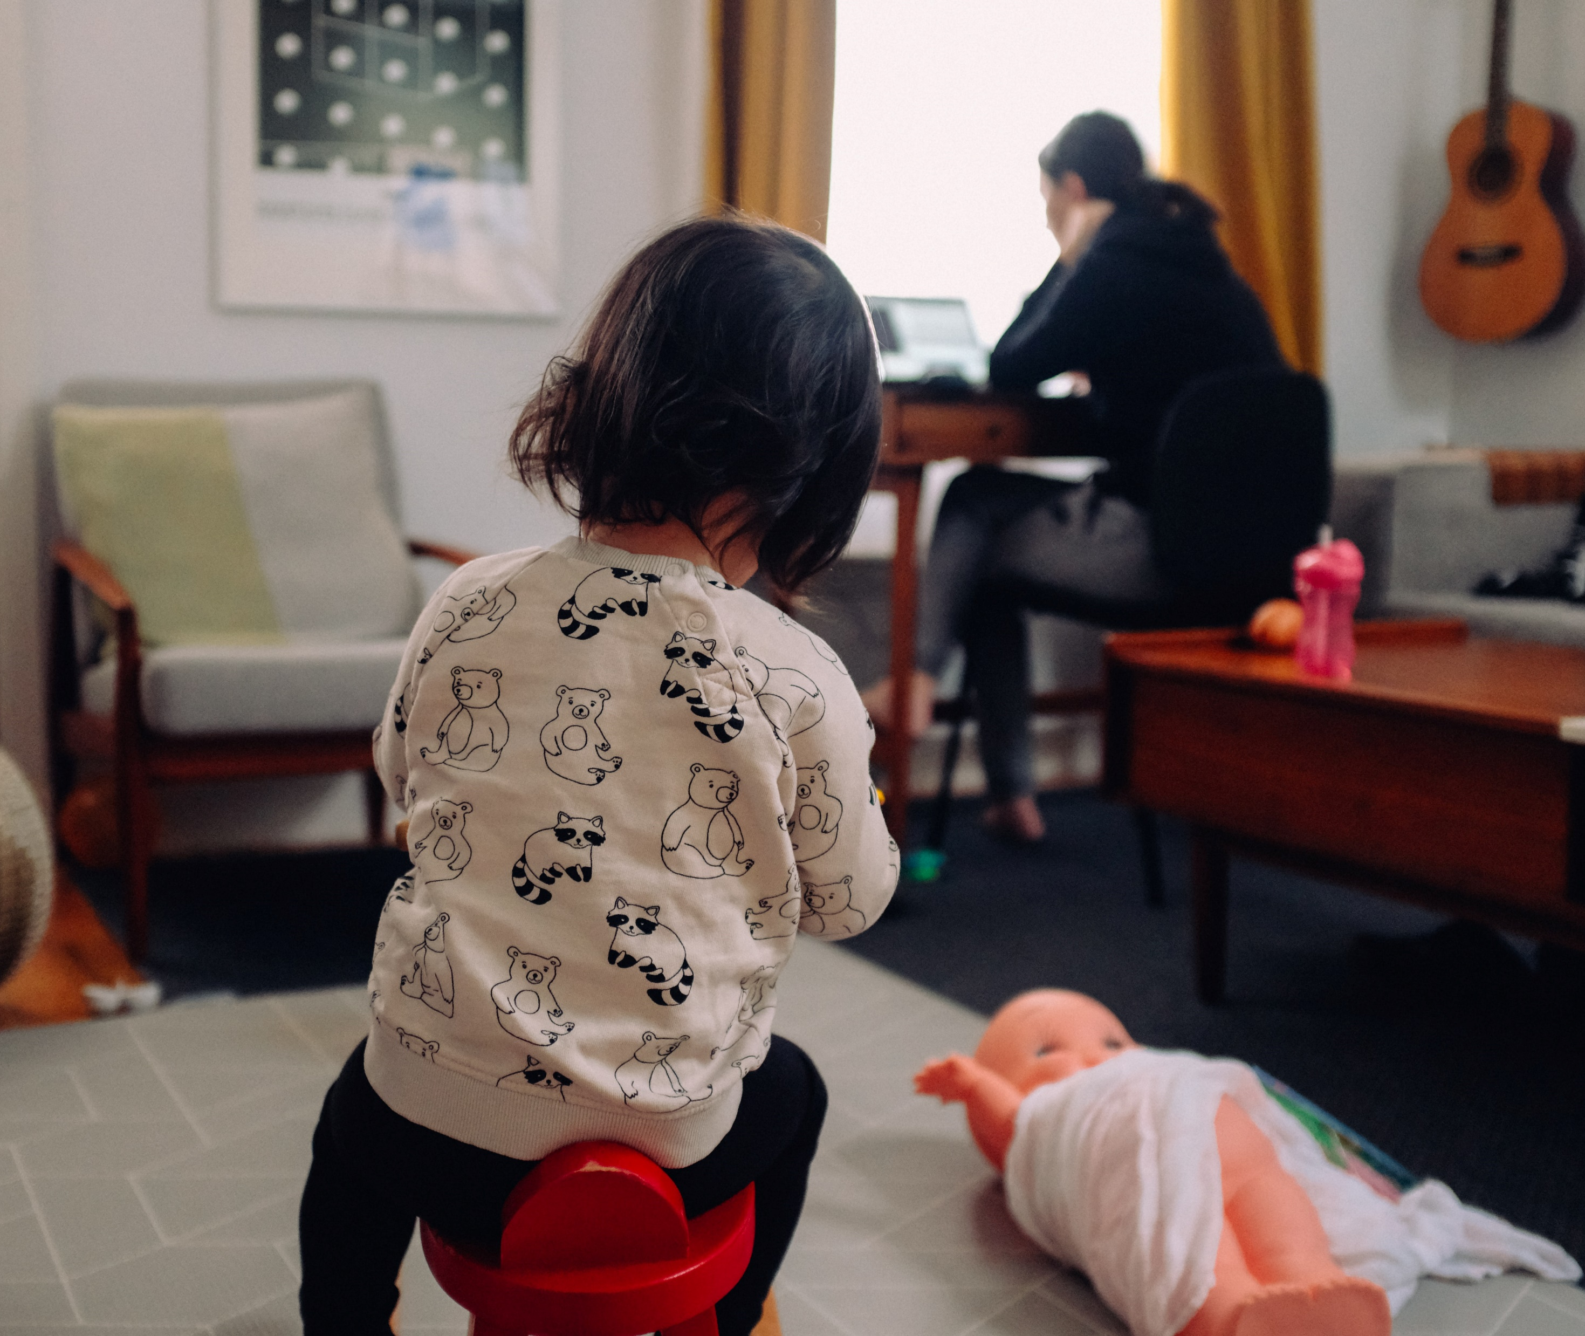


Introduction
Notes:
Bhavya

Slide 4
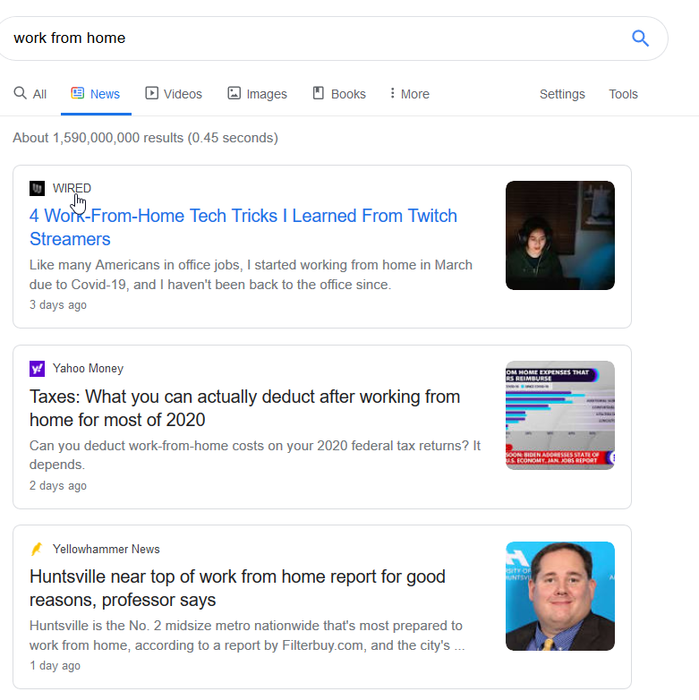
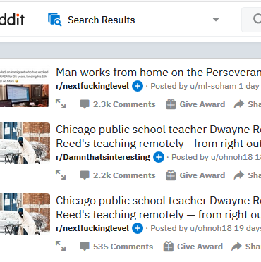
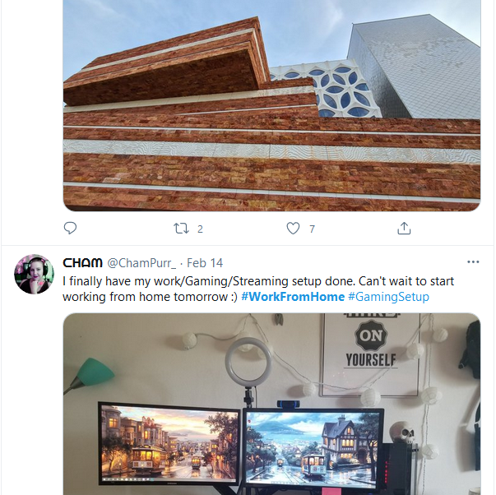



Data Sources

Slide 5
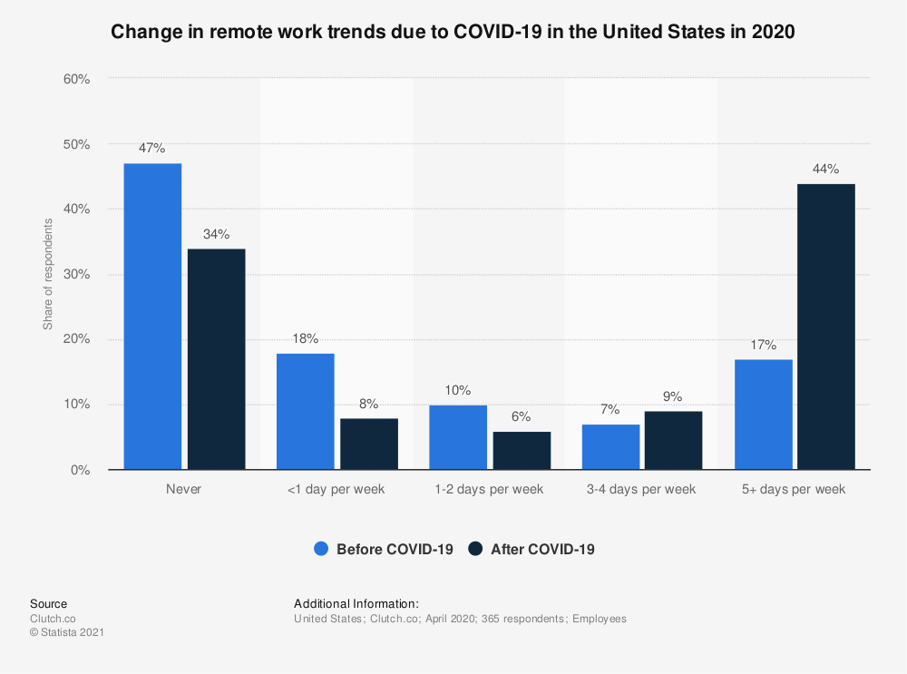
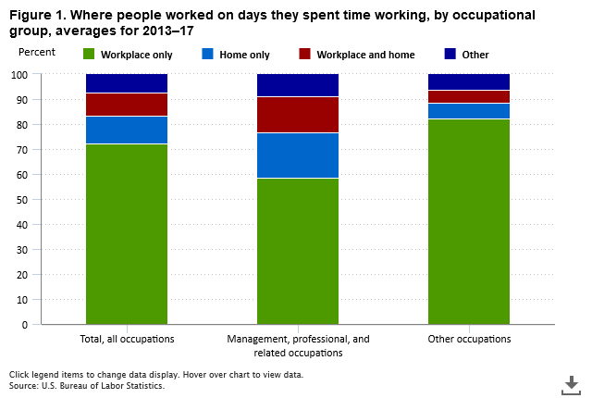
How People feel about working from home?
Notes:
One of the project’s goal is to answer, “How People feel about working from home?”
This can be answered by looking at the question pre-covid and during covid.
This chart shows how the work from home shifted from before to during.

Slide 6
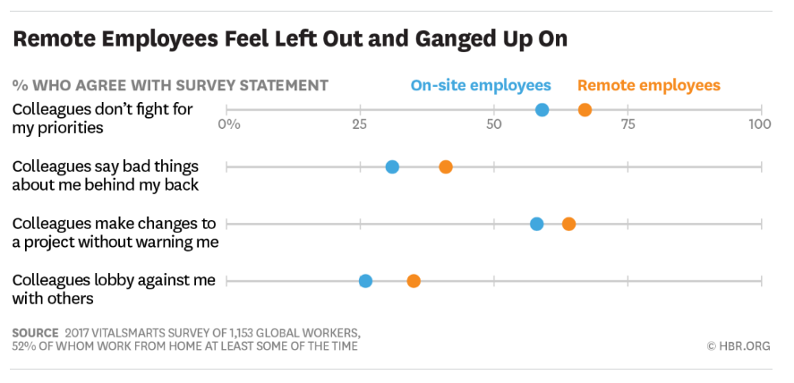
How People feel about working from home?
Notes:
If a single survey is read, it seems like working from home was not the best deal.

Slide 7
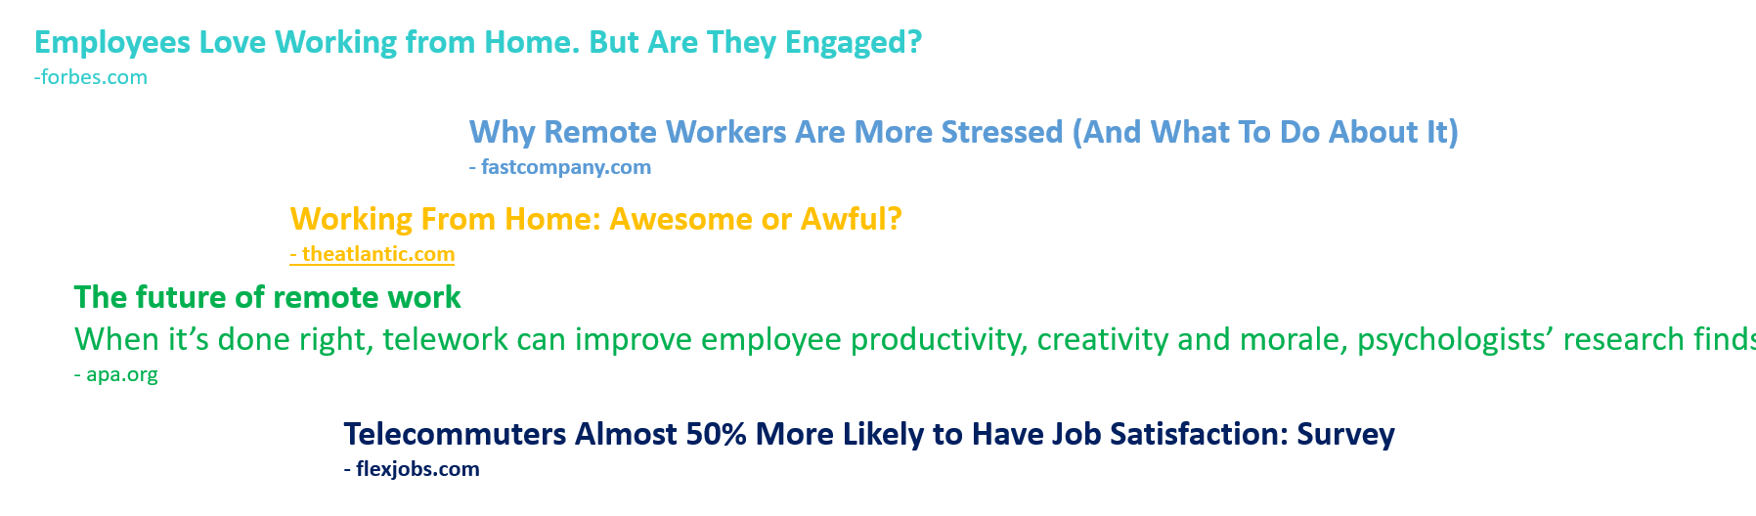
How People feel about working from home?
Notes:
However, when looking at multiple headlines, there was a mixed feeling about working from home.

Slide 8
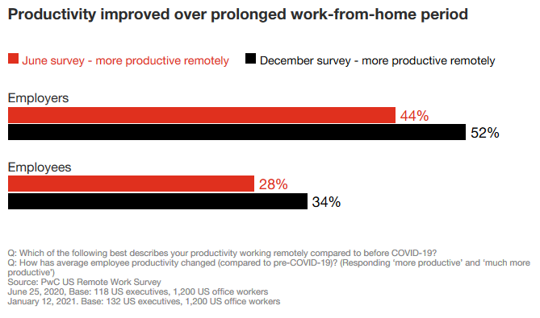
How People feel about working from home?
https://www.pwc.com/us/en/library/covid-19/us-remote-work-survey.html
Notes:
This chart comes from an interesting survey. The survey compares how employers feel about working from home and how employees feel about working from home.
The survey was conducted by PricewaterhousCooper Consulting firm first in June and then in December last year.
The responses were collected from over 100 executives and 1200 employees in the U.S.
This chart suggests that productivity has improved between June and December last year:
- In June last year, only 44% of employers and 28% of employees thought they were more productive working from home.
- In December, over half of employers and 34% of employees thought remove work was more productive.

Slide 9
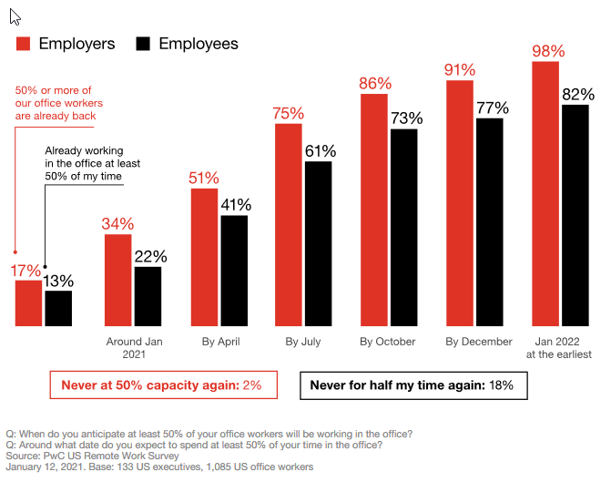
How People feel about working from home?
https://www.pwc.com/us/en/library/covid-19/us-remote-work-survey.html
Notes:
In the survey, the executives were asked the date they expect at least half of their employees will return to office.
The employees were asked the date they expect to return to office for at least 50% of their time.
This chart shows that employers expect employees to return to office sooner than employees do.

Slide 10
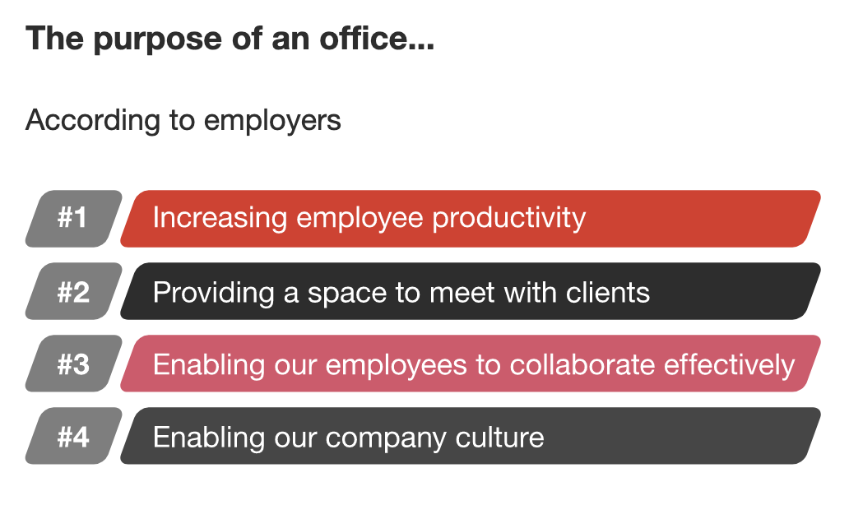
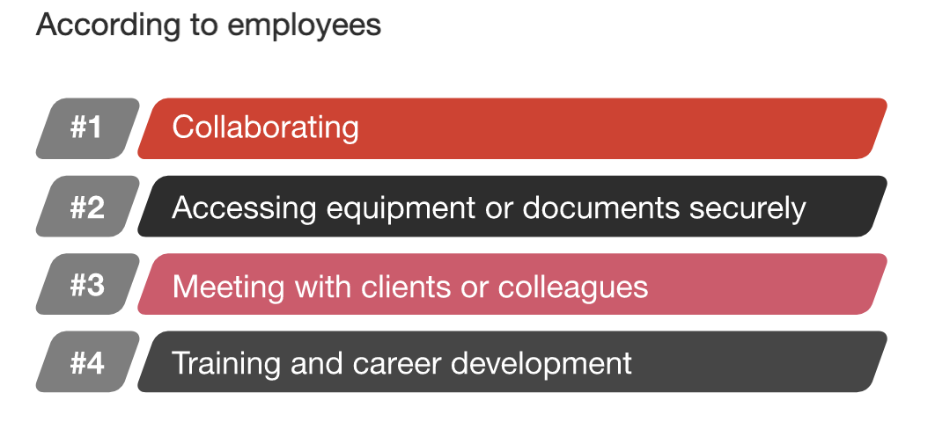
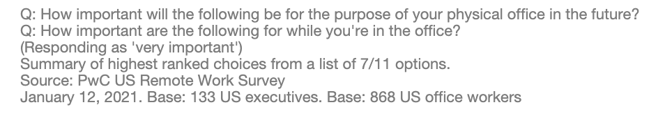
How People feel about working from home?
https://www.pwc.com/us/en/library/covid-19/us-remote-work-survey.html
Notes:
When asked about the purpose of an office – here are their responses.
While both employers and employees think of collaboration and space to meet with clients,
- Employers think of productivity and company culture
- Employees think of access to equipment and documents, and job training

Slide 11
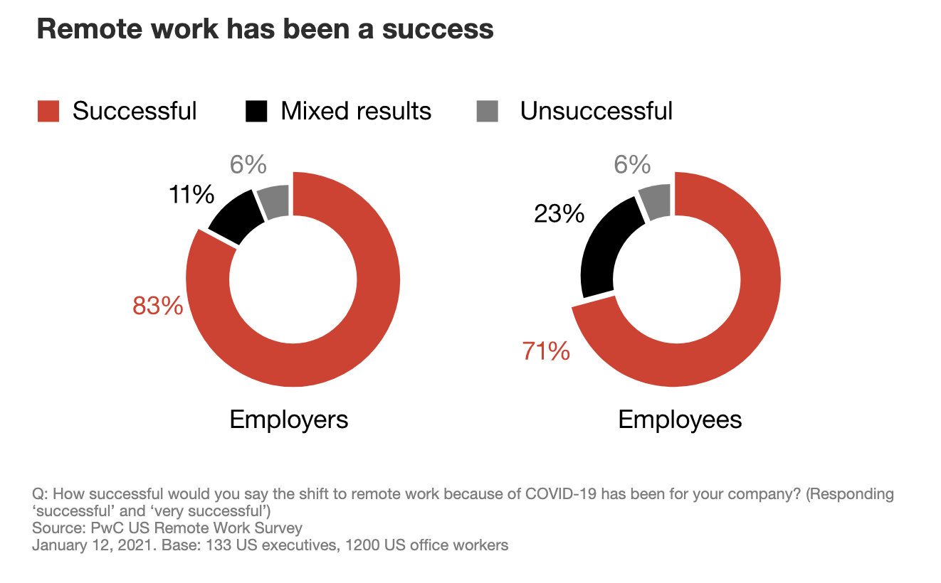
How People feel about working from home?
https://www.pwc.com/us/en/library/covid-19/us-remote-work-survey.html
Notes:
Overall, 83% of employers and 71% of employees thought shifting to working from home has been a success.
More employees reported mixed results. It could be because of the challenges some employees were facing when they worked from home.
Now, passing on to Tamil.

Slide 12
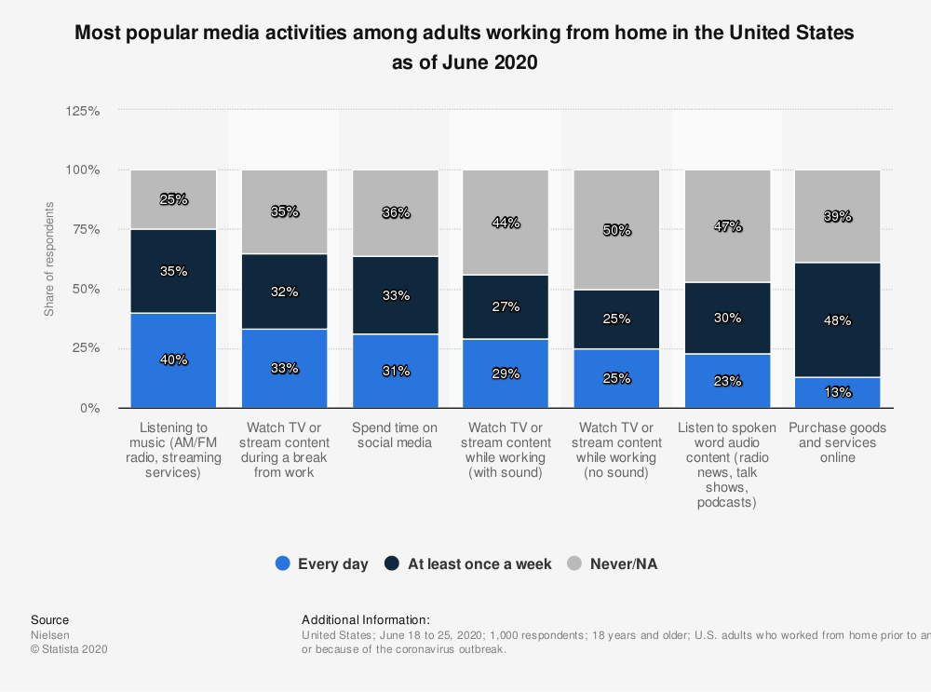
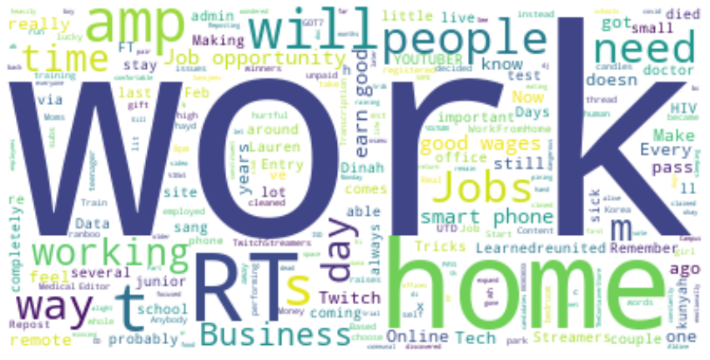
What people are doing during work from home?
Notes:
Tamil

Slide 13
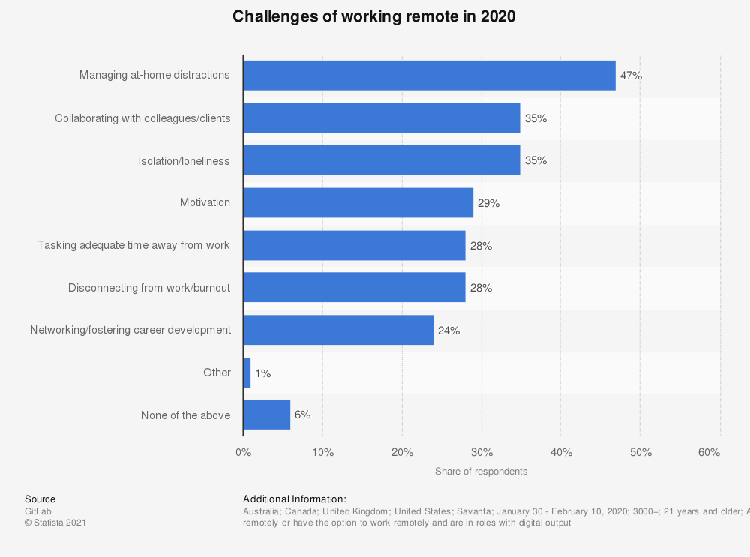
What people are doing during work from home?
Notes:
Tamil

Slide 14
Questions?
Notes:
Tamil

Slide 15
Work From Home
Class -
You will present your ppts for your group project this Sunday.
Each member of the team must talk.
Be succinct and precise and tells us all about the TOPIC and what you want to to learn - NOT how you plan to learn it :)
HINTS:
1) Its not about you :) So do not use "I", "me", "we", "us", "our", etc.
Its always "the data" not "your data"
2) Duration 8 - 11 minutes.
3) Focus - images and about the topic
4) You may show one slide of some raw data BUT do not talk about cleaning.
5) Do not list the methods and models you plan to use as everyone will use the same ones. Focus on the TOPIC - the what, why, who, importance, what you want to learn, what you want to show or see or classify, etc.
** Be careful NOT to go for more than 11 minutes.
Looking forward to it! DrG
How are the workers feeling?
Before Pandemic
During Pandemic
What are they doing?
What are the challenges

